Slide 1
Breaking Through Walls
P2P NAT Traversal with Go

Slide 2
Who am I?
Name’s Biney.
Some random dude interested in learning networking stuff

Slide 3
Wait who am I actually?
My laptop says 172.20.10.6
Google says 154.161.26.65
Living in two different worlds at once
The "Private IP" is just a local nickname

Slide 4
Sharing is caring but it's complicated
IPv4 is a limited resource
The router is playing middleman
Mapping internal ports to the world
The NAT Table keeps track of the lies

Slide 5
Public IPs should act like their names ugh
curl ifconfig.me gives me a public IP
I start a UDP listener on Port 9000
My Hetzner server sends a UDP packet to that IP:9000
What happens?

Slide 6
Locked from the outside
Inbound traffic is guilty until proven innocent
If I didn't ask for it, it doesn't get in
Opening inbound ports: huge security risk
Firewalls are paranoid!

Slide 7
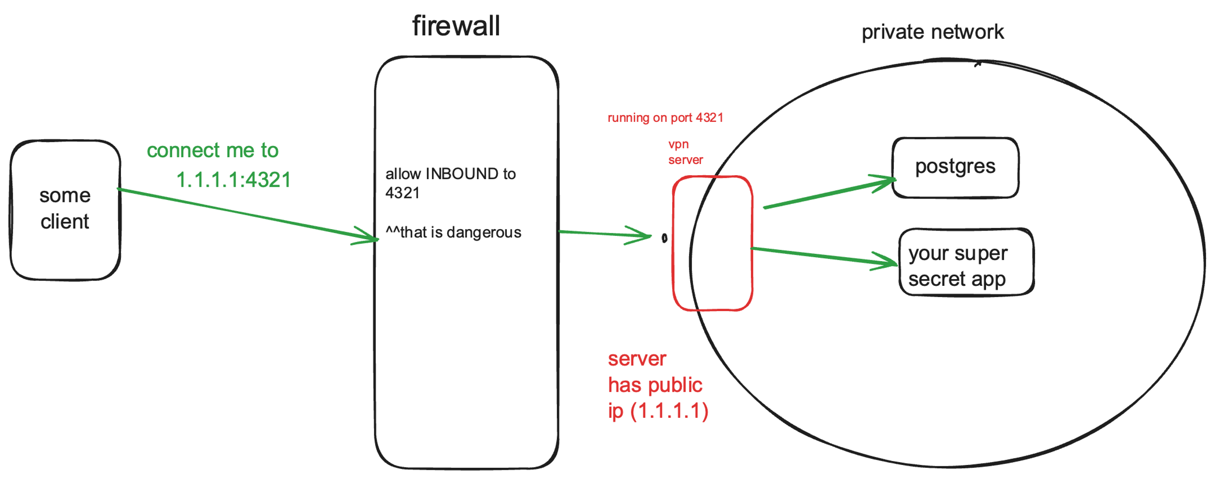
VPN Gateway? That might work

Slide 8
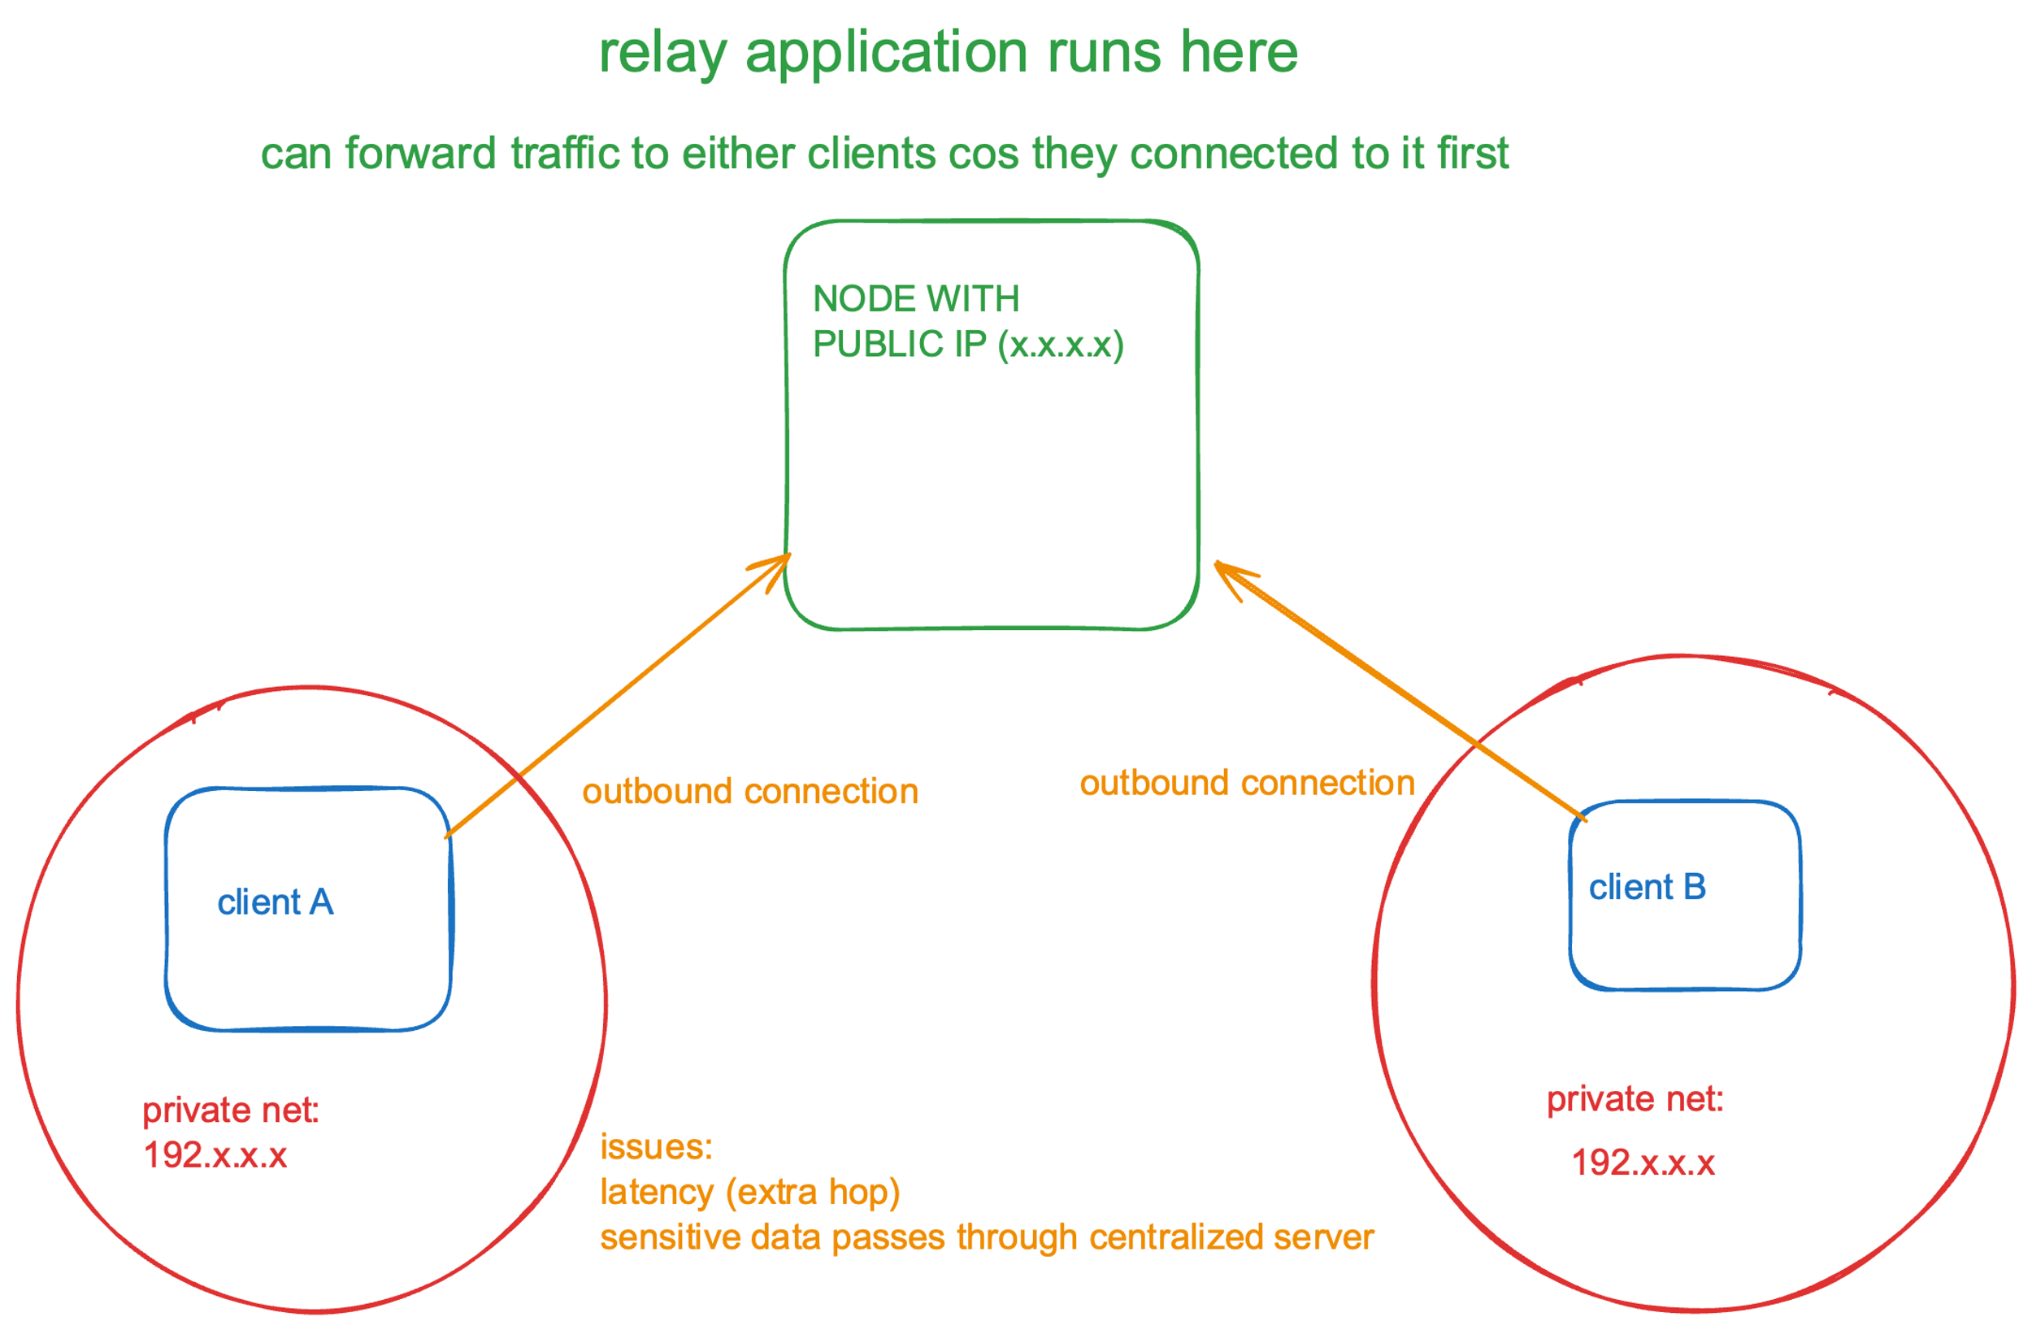
Relays?

Slide 9
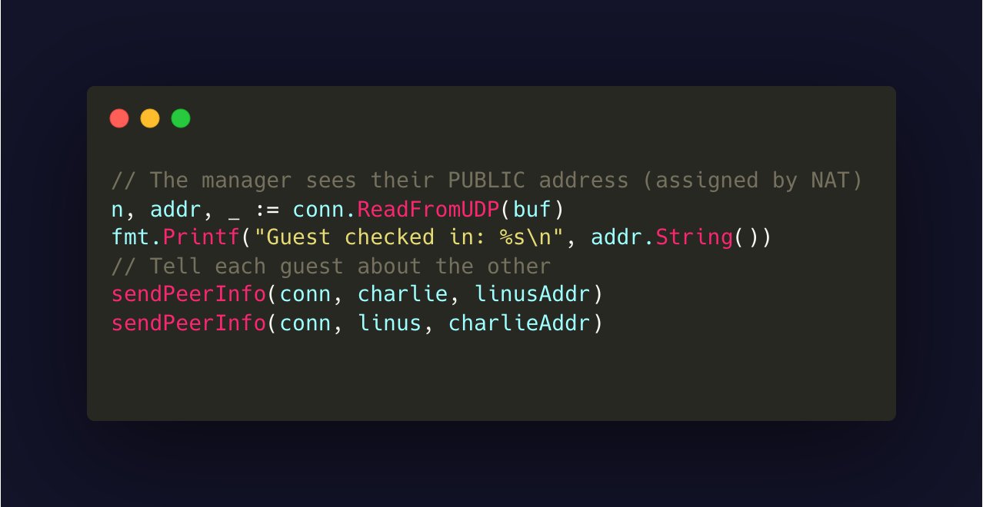
A middleman who just signals

Slide 10
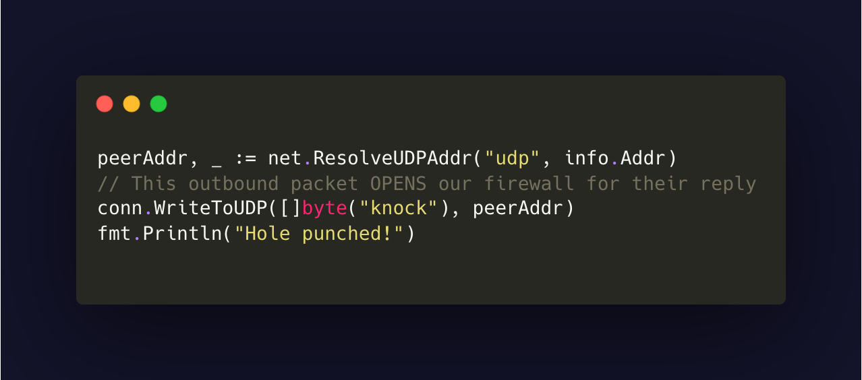
The Simultaneous Knock ☺

Slide 11
Stubborn NATs
Some NATs switch ports for every connection.
Companies like Tailscale use relay servers around the world

Slide 12
DEMO TIME

Slide 13
Further Reading (If Interested)
https://tailscale.com/blog/how-nat-traversal-works
https://docs.netbird.io/about-netbird/understanding-nat-and-connectivity
https://github.com/kwakubiney/nat-traversal

